Slide 1
Project Presentation and Demonstration
Team Name: Team AzDev
Group no: 04
Members:
Chowdhury Mohammad Jarif Ferdous (#103792481)
Hossain Muntasir (#103798748)
Hridoy Ahmed (#103798793)
Sazed Ur Rahman (#103815346)

Slide 3

Overview
Project Purpose
Develop a DevOps Pipeline:
Create an automated pipeline for deploying a web-based weather application.
Streamline software development processes to enhance efficiency.
Automate Processes for Continuous Integration and Deployment:
Implement continuous integration (CI) and continuous deployment (CD) practices.
Ensure that code changes are automatically tested and deployed to production.
Key Components
Version Control: Usage of GitHub for code management, tracking changes, and collaboration.
CI/CD: Utilizing GitHub Actions for automating build, test, and deployment processes.
Testing: Integrating automated testing to ensure code quality and functionality.
Production Deployment: Deploying the application on Azure for robust production management.

Slide 4

Project Background
Importance of DevOps
Modern software deployment requires speed, scalability, and automation. DevOps practices streamline development and operations, enabling continuous integration and continuous deployment (CI/CD) for faster, more reliable software delivery.
Focus
This project focuses on deploying a Python Flask weather app using a CI/CD pipeline on Azure, ensuring automated testing, building, and deployment.
The pipeline leverages GitHub Actions for automation and Azure App Service for deployment, demonstrating the effectiveness of DevOps in simplifying deployment workflows and reducing errors.

Slide 5

Project Scope and Objectives
Scope:
Develop a weather application retrieving data from OpenWeather API.
Build a CI/CD pipeline using GitHub Actions for automation of integration.
Deployment and Monitoring.
Automatic scaling.
Deliverables:
Documented CI/CD pipeline.
Fully functional weather app.
Automated scaling setup.
Monitoring.

Slide 6

Project Outcome/Deliverables
Fully Functional Web-Based Weather Application:
An application that retrieves and displays current weather data using the OpenWeather API.
Documented CI/CD Pipeline Setup:
Comprehensive documentation outlining the pipeline configuration and workflows.
Deployed Application on Azure:
The application will be hosted on Azure, with infrastructure managed automatically.
Performance Monitoring and Automation with Azure:
Monitoring application health, performance, and resource usage and Automating Deployment when triggered.
User Manual and Project Closure Report:
A guide for end-users on how to navigate and utilize the application effectively.
Final report summarizing the project outcomes, lessons learned, and recommendations.

Slide 7
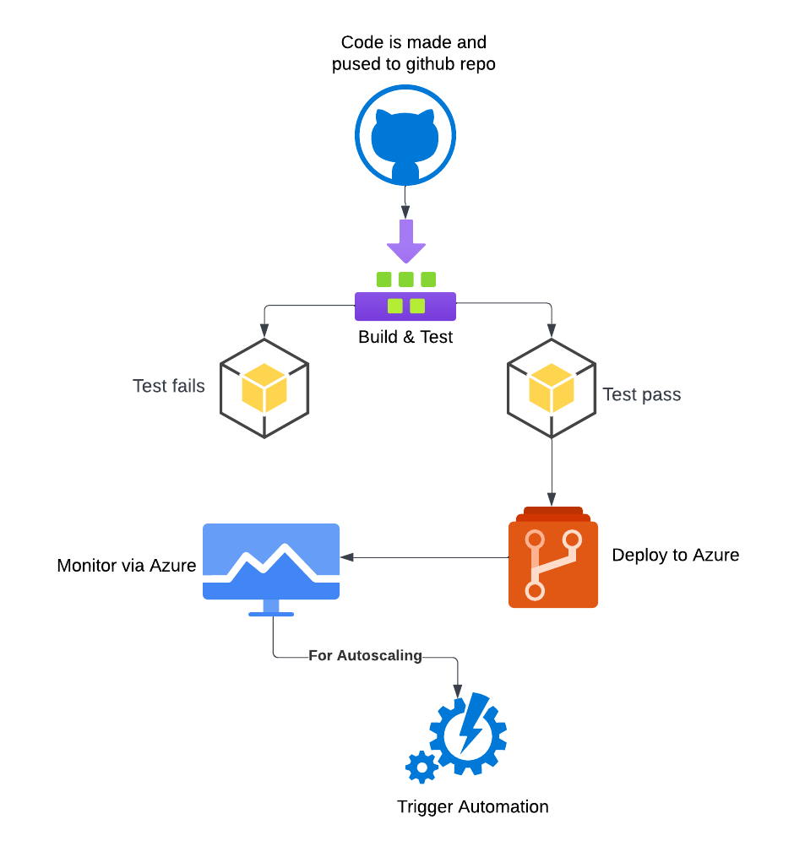
Preliminary Design Concept
CI/CD Pipeline Overview
Goal: Automate testing, building, and deployment when code changes are made
Tools Used:
GitHub: Version Control, Enabling collaboration and Tracking changes.
GitHub Actions: Automatic Build and Unit Testing.
Azure App Service : Deployment, Monitoring, and Scaling
Workflow:
Push Code to GitHub: Developers commit code changes to the repository.
Automated Testing and Deployment: GitHub Actions automatically triggers builds and tests; successful tests lead to deployment in Azure
Monitoring and Scaling: Continuous monitoring and automatic scaling via Azure.

Slide 8

Compatibility of Design
Functional Requirements:
DevOps Pipeline Design, Automation of Deployment, Application Deployment
Performance Monitoring and Metrics
Instrumentation, Real-time Monitoring
Tool Selection Justification
Documentation

Slide 9

Justification
Tool Selection Justification
Github
Version Control
Integration with CI/CD tools
Github Actions
Workflow Automation
Cloud Native
Azure App Services
Publish profile simplified deployment
Built in Monitoring
Notable Comparision of Azure vs AWS
Streamlined approach as compared to AWS issues
Easier role management compared to AWS
AWS: Basic authentication issues while setting up the publish profile, Auto-scaling group creation failed, Service roles and instance profiles were missing or misconfigured

Slide 10
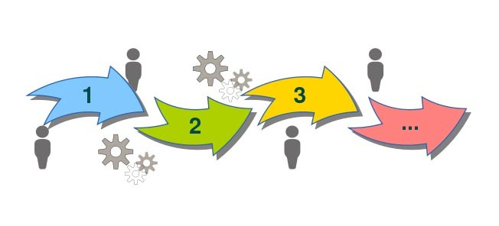
Code Demonstration
Weather App Overview
• Python (Flask Framework)
• HTML/CSS for front-end
• Requests Library for API calls
Required Libraries
blinker==1.8.2, certifi==2023.7.22, charset-normalizer==3.3.0, click==8.1.3, colorama==0.4.6, Flask==3.0.3, idna==3.4, itsdangerous==2.2.0, Jinja2==3.1.4, MarkupSafe==2.1.5, requests, urllib3==2.0.6, Werkzeug==3.0.4, gunicorn==22.0.0

Slide 11
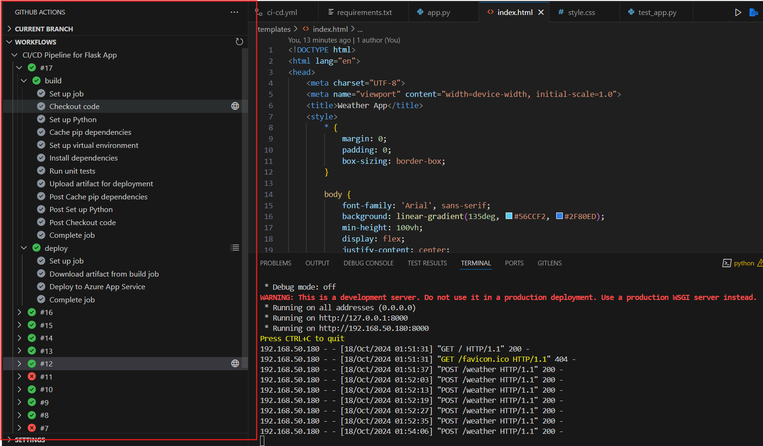
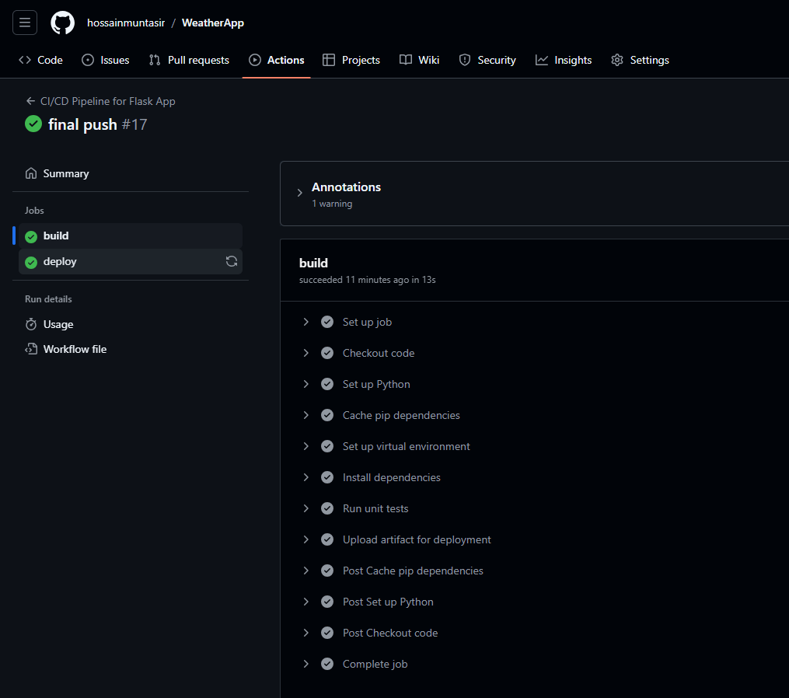
Code Demo (Part 1) Live Demo
GitHub Actions Panel
Displays runtime log
GitHub Actions Run Summary
Shows completed build and deploy stages, ensuring the app is only deployed after passing tests.

Slide 12
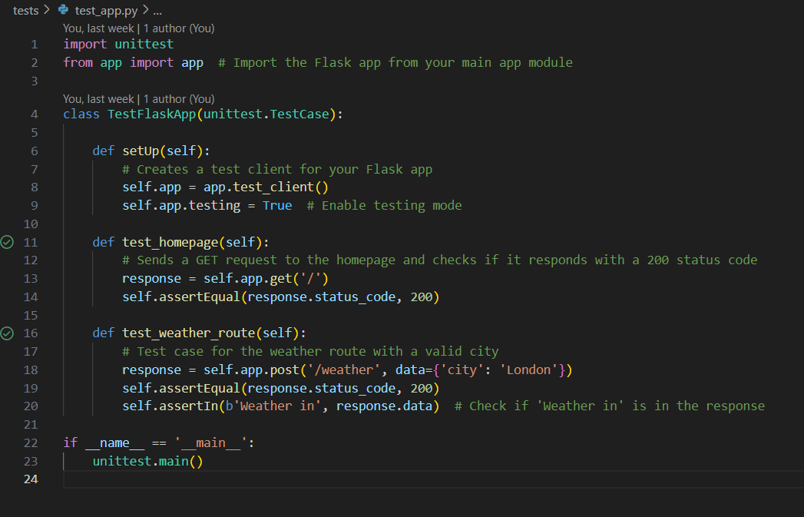
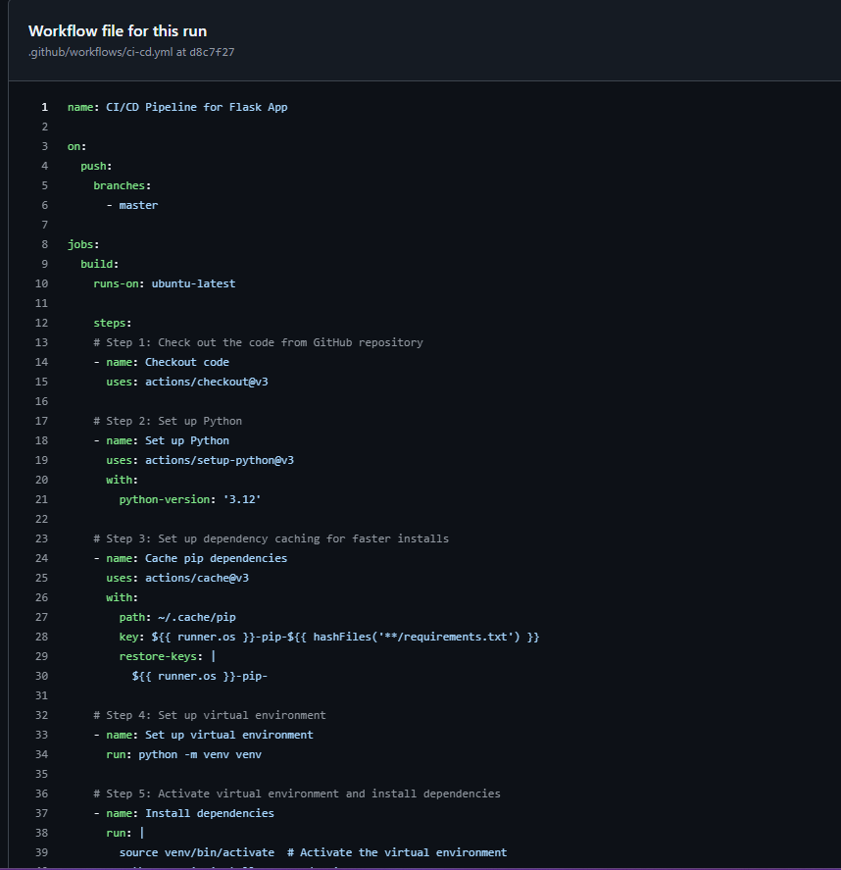
Code Demo (Part 2)
Unit Test File
Python unit tests ensure correct responses for the homepage and weather API routes.
Workflow YAML File
Defines the CI/CD pipeline steps, such as code checkout, dependency setup, and testing.

Slide 13
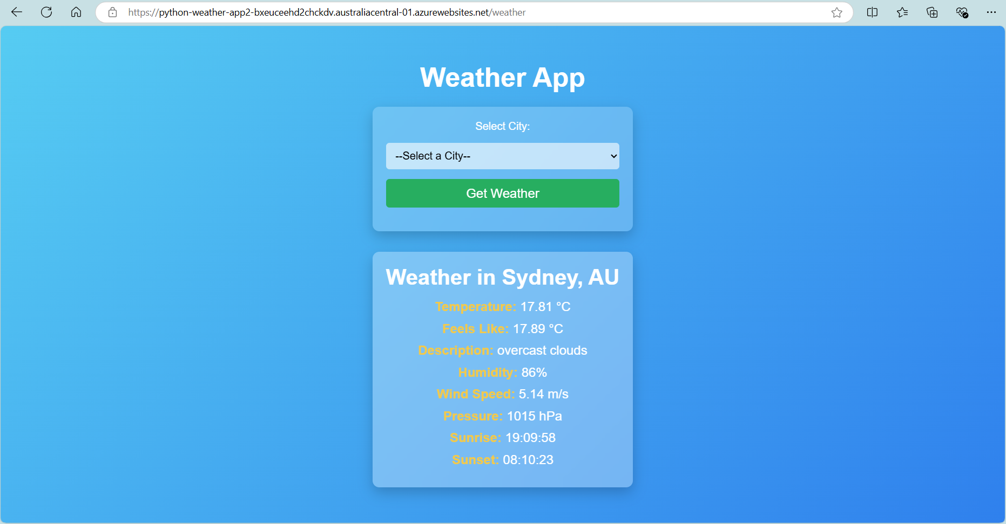
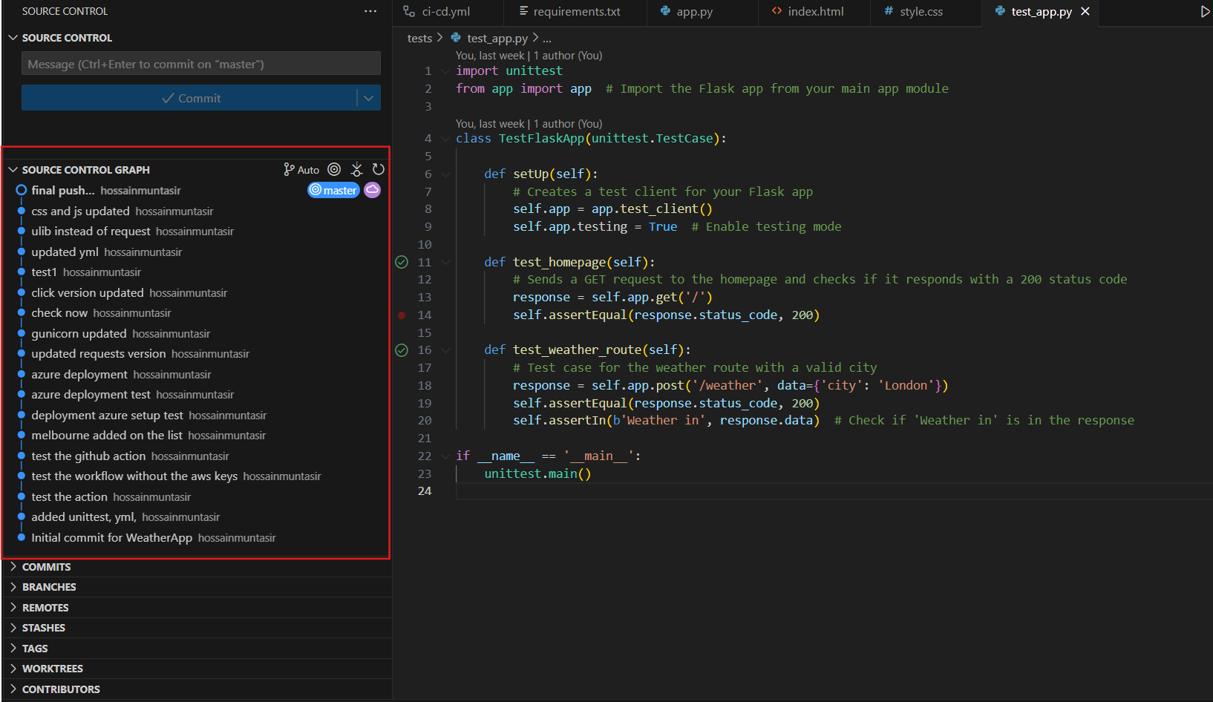
Code Demo (Part 3)
Live Weather App
Deployed app showing real-time weather data for selected cities with a user-friendly interface.
GitHub Commit Log
Displays version control history with important commits like deployment setup and test updates.

Slide 14
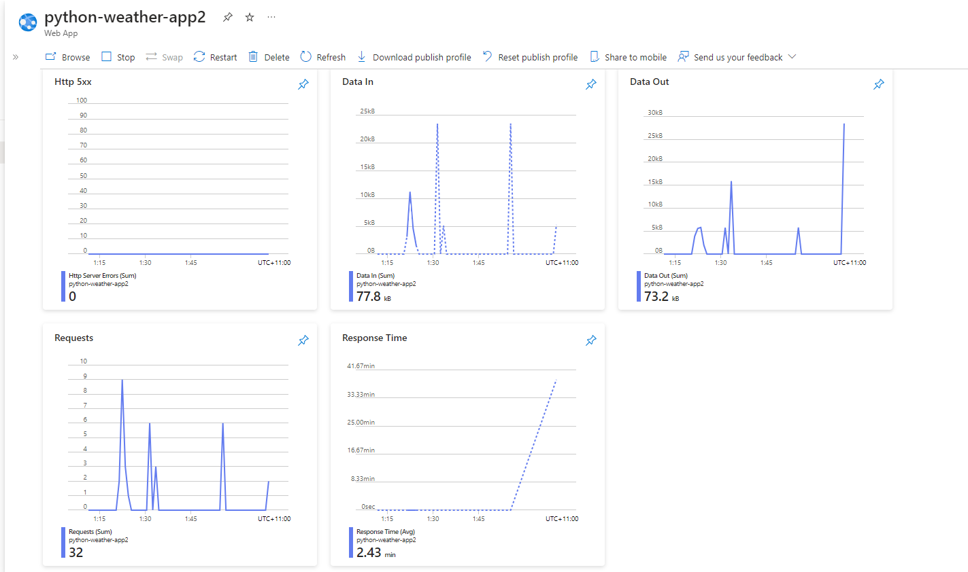
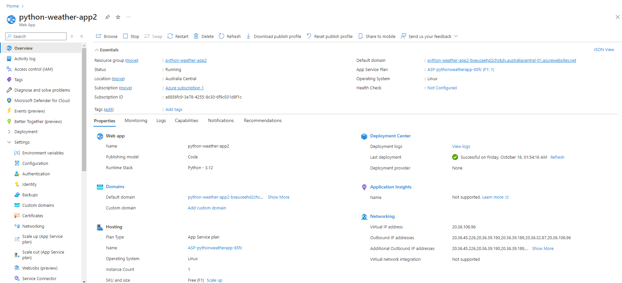
Code Demo (Part 4)
Azure Monitoring Dashboard
Performance metrics - response time, requests, and data usage for real-time monitoring.
Azure App Dashboard
Overview of Deployment of weather app.

Slide 15

Where We Stand
Learnings and Next Steps
What we have learned from the project
• Understanding cloud platform configurations is essential
• CI/CD pipelines significantly improve deployment efficiency
Future works
• Continue adding features and explore containerized deployment (Docker/Kubernetes)
Available At
https://python-weather-app2-bxeuceehd2chckdv.australiacentral-01.azurewebsites.net/
Questions if any!

Slide 16
Thank you

